Slide 1


Slide 2
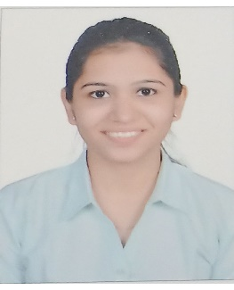
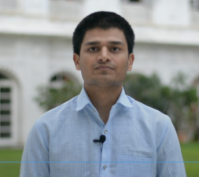
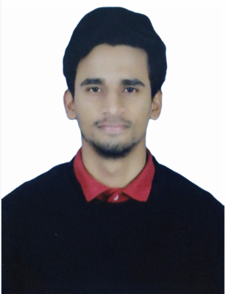
Project Highlights
Project Name : COVID 20
Team Size : 3
BU Mentor Name : Jagadeesh B, Roshan Noronha, Milind Hatkhamkar
Team Members Details :
Shweta Melavane
PS#99002488
2009BLRICP01
B.Tech, EXTC
Time Management, Teamwork
Shrikant Barkale
PS# 99002458
2009BLRICP01
B.E ECE
Team Player, Mentoring
Harshith H K
PS# 99002442
2009BLRICP01
B.Tech CS
Time Management, Interpersonal Skills, Management Skills

Slide 3
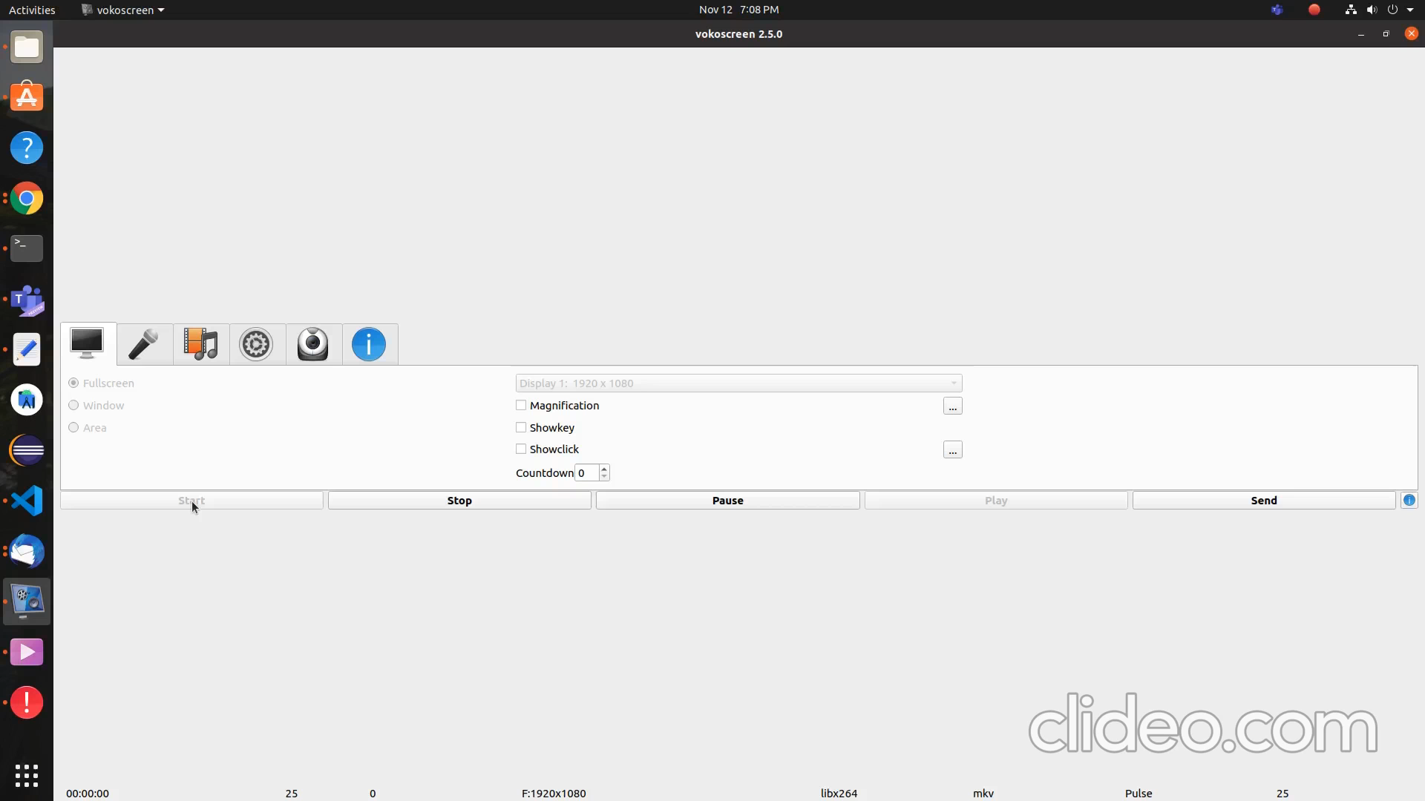
Project Video Snippet

Slide 4
Future development that can be implemented further
Add a proper dedicated back end support with Database support.
Each login, Register, Forgot Password pages can also be designed in attractive way
Home page can have more redirecting links lined to it
Add more API’s to the Project and make it much more helpful.
Make a native App out of it.

Slide 5


Thank You !

